Slide 1



Capstone Project
Northwind Traders Sales Analysis

Slide 2

Project overview
Northwind Traders is a wholesale distribution company that purchases products from various suppliers and sells them to customers across multiple countries. The database captures customer transactions, product details, supplier information, and employee sales activities, making it suitable for comprehensive sales and business performance analysis.
This project analyzes the sales performance of Northwind Traders, a wholesale food distribution company. The objective of the analysis is to evaluate revenue performance, customer behavior, product contribution, geographic distribution, and operational efficiency using structured business intelligence techniques.
The dataset includes transactional and master tables such as customers, orders, products, categories, suppliers, order details, employees, and shipper.
lacus.

Slide 3

Objective of the Analysis
The primary objectives of this sales analysis are:
To analyze overall revenue performance and growth trends
To identify top-performing products and categories
To evaluate customer revenue contribution and dependency risk
To examine geographic sales distribution
To assess order patterns and operational efficiency

Slide 4

Key Insights
The analysis indicates that while the company demonstrates steady growth and strong performance in core markets, revenue concentration in specific customers, categories, and regions presents moderate risk. Diversification strategies and targeted marketing initiatives could improve long-term stability and growth.
Some important key insights are:
Revenue distribution
Sales show a consistent growth trend over time.
Revenue is moderately concentrated among top-performing categories.
Revenue is concentrated in a few key countries.
Customer Analysis
A small percentage of customers contribute a significant portion of total revenue.
High-value customers represent strong revenue drivers but introduce dependency risk.
Category & Product Analysis
Certain categories generate the majority of sales.
Some low-performing products may require pricing or promotional adjustments.
Market Trend Analysis
Order volume trends align with seasonal demand patterns.
Average Order Value indicates stable purchasing behavior.

Slide 5
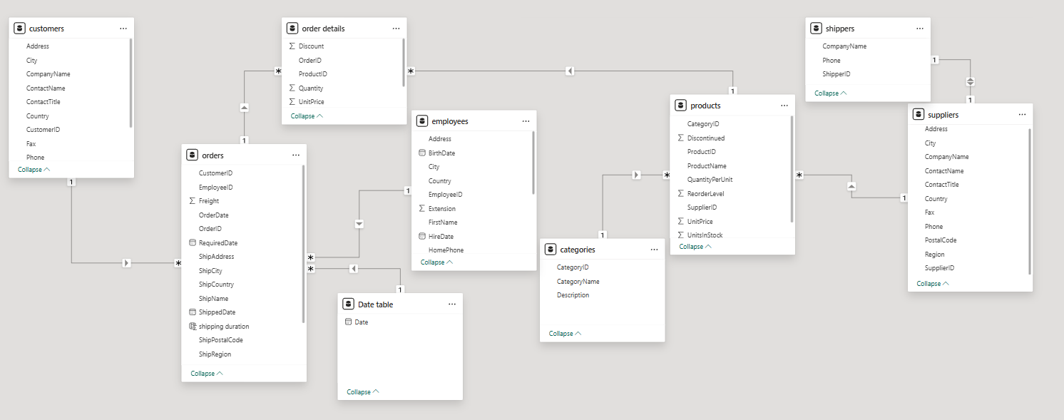

ER Diagram

Slide 6
MECE Breakdown
Revenue distribution by Country | Revenue distribution by City | Revenue distribution by region
The objective of this analysis is to understand how revenue is distributed across different countries and identify key revenue-driving markets. | The key objective of this analysis is to identifies the highest revenue generate by the customers belongs to which city. | The objective of this analysis is to understand how revenue is distributed across different cities in product wise and identify key revenue-driving markets in city wise.
Customer Base Overview | Customer Order Behavior | Customer Segmentation
In this matrix, the major focus is getting the information about the total customer in city wise or country wise, out of that how many active customers are there. | This helps to know about the customer buying behaviors by separating the customer based on the average order and their repeat rate. | In this, we can fit the customers based on the different segments like: High value customers Medium-value customers Low-value customers
Category Performance | Product Performance | Pricing & Demand Analysis
This matrix focuses on the Product-level profitability and demand.it evaluates the sales by category , quantity sold and revenue contribution of the different product category. | Evaluate the performance of the products based on the top 10 products by revenue, lowest performing products, high revenue but low quantity products. | The main purpose is to identifies the most demanded products on market based on the price. By evaluating average unit price by category, sales vs quantity relationship, discount impact.
Order value Analysis | Shipping Analysis | Order Volume
Evaluate average order value and overall order size distribution across the countries. | Evaluate the delivery performance or standard duration of the delivery of the product and order by shipper. | Evaluate the total order of the product by calculating total orders and order over time.
Growth trend | Seasonality | Sales spike
Focuses on sales over time (monthly, yearly, quarterly). This analysis tracks how revenue changes over time. | Seasonality means recurring patterns in specific months or special occasion like festive season sales etc. | Spikes are sudden increases in revenue in specific months or Day.
Revenue Distribution
Customer performance Analysis
Product & Category Performance
Order and supply Analysis
Trend Analysis

Slide 7

EDA Problem Statements
Excel & SQL

Slide 8
1. What is the average number of orders per customer?
Conclusion
Many of the customers have ordered fewer orders than the average of 9.3.
The sales team can focus to improve the loyalty and repeat customers

Slide 9
2. How do customer order patterns vary by city or country?
Conclusion
USA & Germany has higher number of Orders.
The number of orders in a country varies with the number of cities served in the country. More the number of cities served, more the orders in the country

Slide 10
3. Can we cluster customers based on total spend, order count, and preferred categories?
Conclusion Customers in the Northwind dataset can be clustered based on total spend, order frequency, and preferred product categories. This helps identify high-value customers, frequent small buyers, and occasional customers, supporting targeted marketing and sales strategies.

Slide 11
4. Which product categories or products contribute most to order revenue?
Conclusion In the Northwind dataset, a few product categories such as beverages and confectionery typically contribute the most to order revenue. Additionally, a small number of high-performing products generate a significant share of total revenue.

Slide 12
5 .Are there any correlations between orders and customer location or product category?
CONCLUSION Yes, there is a clear corelation between customer location and product category preferences.
some regions consistently place more orders and show stong affinity towards specific product categories,as indicating opportunities for that specific region inventoery planning and targeted marketing.

Slide 13
5. How frequently do different customer segments place orders?
Conclusion Different customer segments in the Northwind dataset show varying order frequencies, with some segments placing orders regularly while others order occasionally. High-frequency customers contribute to steady revenue, while lower-frequency customers represent growth opportunities.

Slide 14
6. What is the geographic and title-wise distribution of employees?
Conclusion The graph shows that employees are mainly concentrated in key business locations, with most employees working in sales-related roles. Management and leadership roles are fewer and typically located in central office regions.

Slide 15
7. What trends can we observe in hire dates across employee titles?
Conclusion Hiring trend shows that year wise there is a single hiring of saleS manager and inside sales coordinator
And steady growth of sales representative by month wise in the year of 1993 and 1994.so we can hire more employee to increase our sales in up coming year.

Slide 16
8. What patterns exist in employee title and courtesy title distributions?
Conclusion The equal representation of Mr and MS indicates a balanced gender distribution in workforce , suggesting inclusive hiring practices across role. Aslo it shows that, hiring decision are primarily role and skill-based rather than influenced by gender.

Slide 17
9. Are there correlations between product pricing, stock levels, and sales performance?
Conclusion lower price product tends to drive higher sales volumes , while higher-priced products contribute more per-unit revenue but there is no sale and have more stocks. products with low price have consistently low stock but high sales indicate strong demand potential lost revenue due to stock-outs. pricing strategy appears aligned with inventory planning, with high-price products carrying lower stock level.

Slide 18
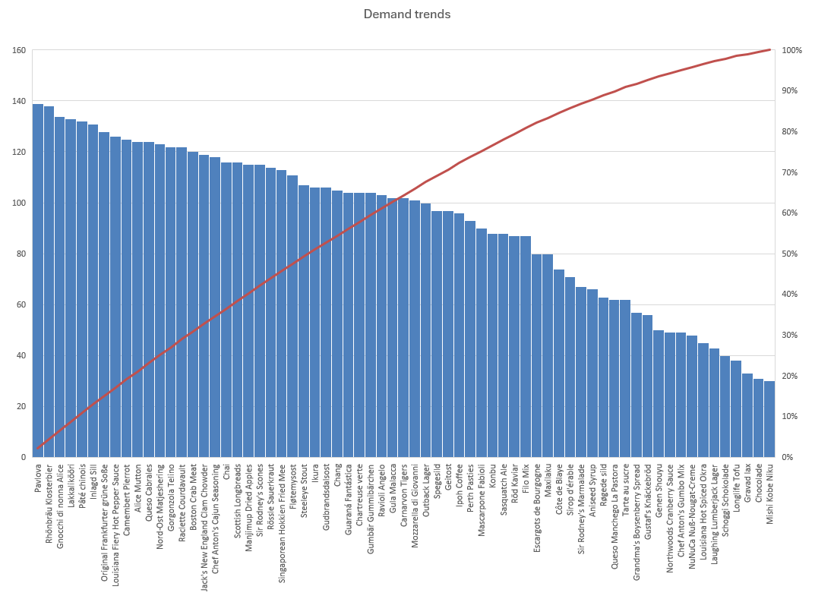
10. How does product demand change over months or seasons?
Conclusion product demand shows clear monthly fluctuation, indicating seasonal buying behaviour. certain products like Raclette courdavalut, konbu etc are experience recurring demand spike on the month 5 , suggesting strong seasonality. overall demand tends to increase during peak seasons and soften during off-peak periods.

Slide 19
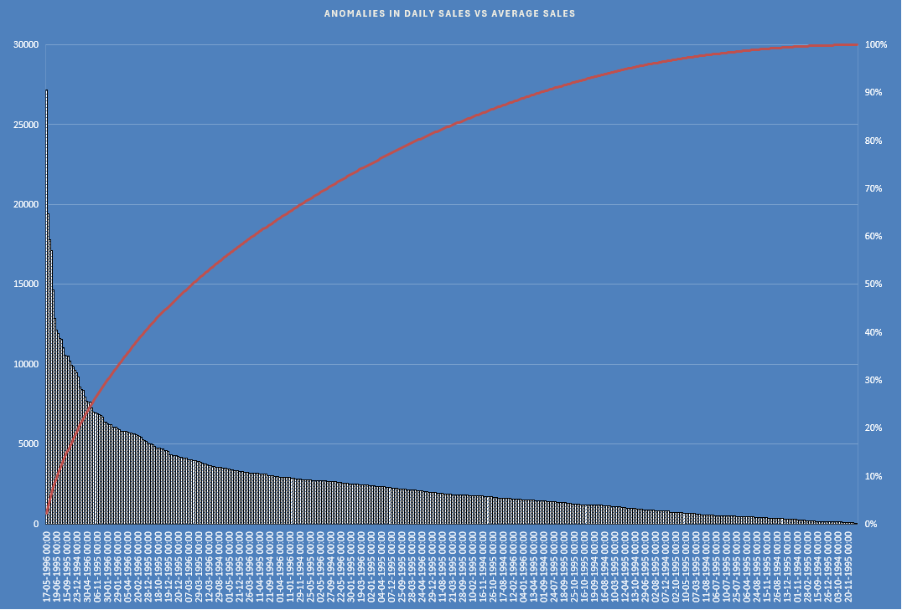
11. Can we identify anomalies in product sales or revenue performance?
Conclusion A large negative sales indicates product or overall revenue performed below the average revenue. So it is a potential performance issue or unusal event affecting demands. Even though overall monthly sales are below average , and certain days shows unusally high sales. This shows that certain days experienced positive spike , it indicates temporary demand of the market event.

Slide 20
12. Are there any regional trends in supplier distribution and pricing?
Conclusion Supplier distribution analysis shows geographic concentration of vendors,while pricing trends indicates cost variation across region .certain region like europian suppliers dominating premium products, where as other provides lower pricing.

Slide 21
13. How are suppliers distributed across different product categories?
Conclusion categories with more supplier indicates strong supply compitation and reduce risk , while category with fewer suppliers indicate potential supply chain dependency.

Slide 22
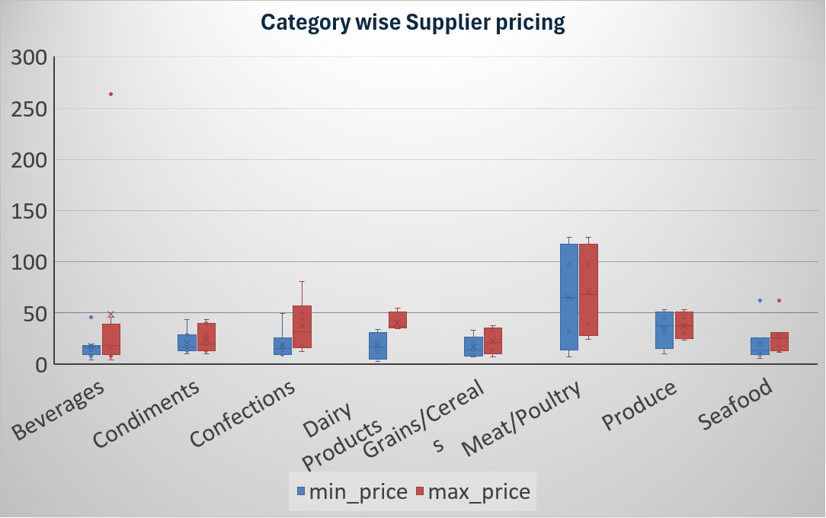
14. How do supplier pricing and categories relate across different regions?
Conclusion The analysis shows that supplier pricing varies across country in same categories. some suppliers supplies max-price in same country but others are supply in cost efficient products. this helps businesses balance quality sourcing and cost optimization.

Slide 23
Power BI Problem Statements

Slide 24
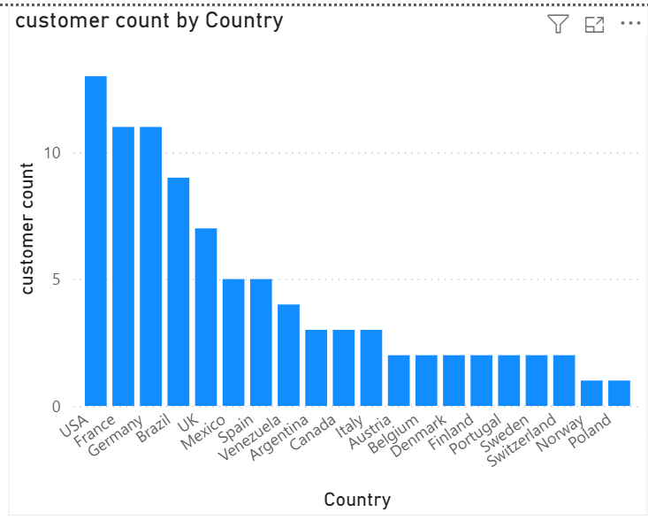
1. How does customer distribution vary across different countries or cities? Use bar chart or map to visualize.?
Conclusion
﻿﻿USA had the highest customer count at 13, followed by Germany and France, which tied for second at 11.﻿
﻿
Across all 20 Country, customer count ranged from 1 to 13.﻿

Slide 25
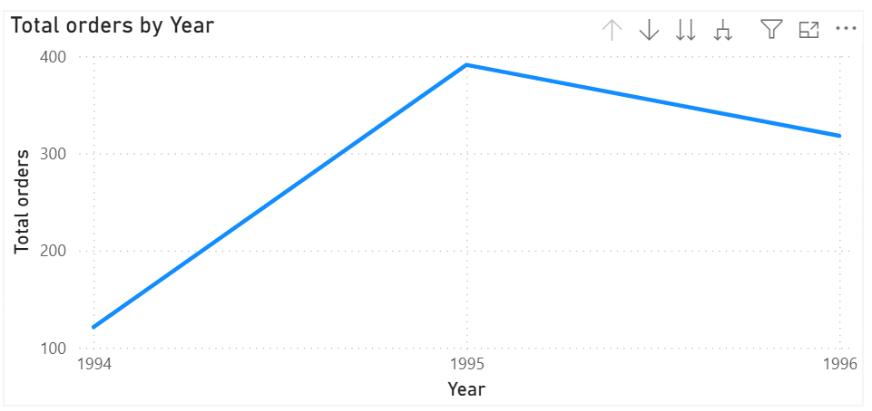
2. What is the trend in customer orders over time? Use line chart or area chart to visualize ?
Conclusion
﻿Total orders trended up, resulting in a 162.81% increase between 1994 and 1996.﻿
Total orders started trending up on 1994, rising by 162.81% (197) in 2 years.﻿
Total orders jumped from 121 to 318 during its steepest incline between 1994 and 1996.﻿

Slide 26
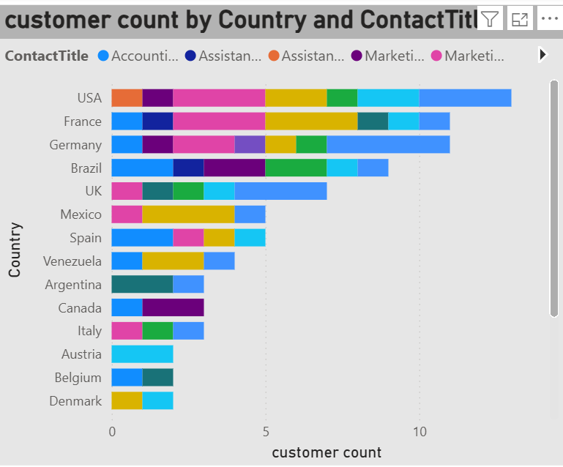
3. What is the distribution of customers by Contact Title or Region? Use stacked bar chart or pie chart to visualize?
Conclusion ﻿Germany in ContactTitle Sales Representative made up 4.44% of customer count.﻿ ﻿Average customer count was highest for Marketing Manager at 1.71, followed by Sales Representative and Owner.﻿

Slide 27
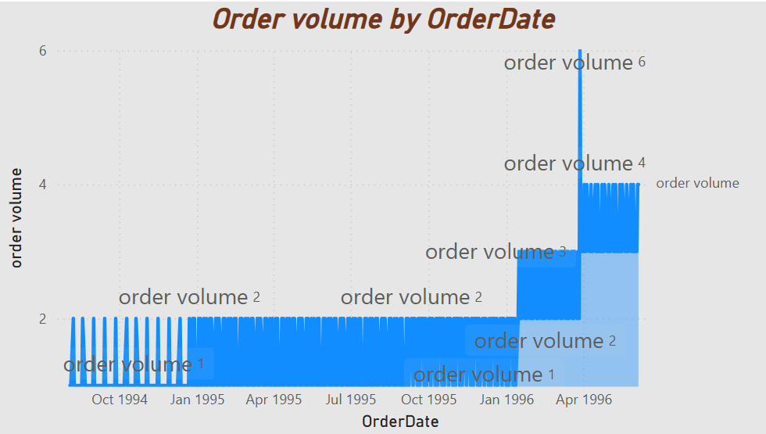
4. How does order volume change over time? Use line chart or stacked bar chart to visualize ?
Conclusion
﻿order volume trended up, resulting in a 300.00% increase between Thursday, August 4, 1994 and Wednesday, June 5, 1996.﻿

Slide 28
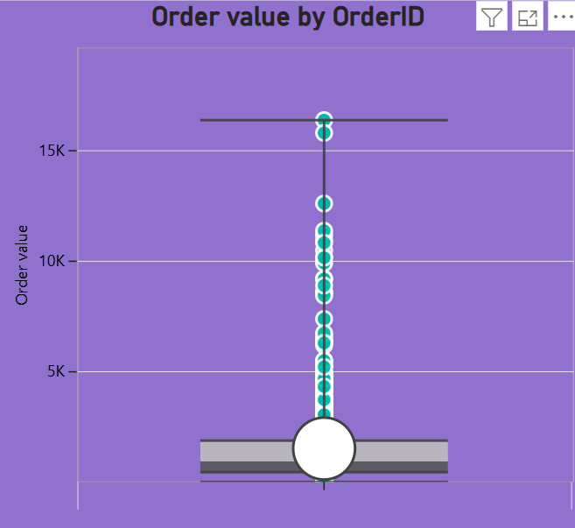
5 . What is the distribution of order values? Use histogram or box plot to visualize
CONCLUSION The Northwind order values are fall down, with most orders being small to medium and a few high-value orders contributing significantly to total revenue.

Slide 29
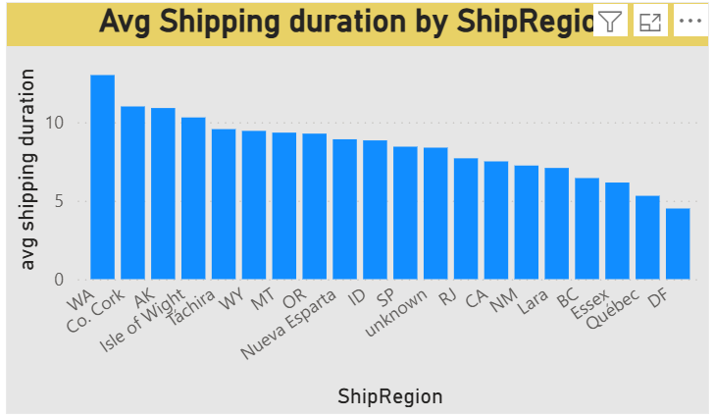
6. What is the average order shipping duration? Use bar chart or box plot to visualize
Conclusion ﻿At 13, WA had the highest avg shipping duration and was 188.89% higher than DF, which had the lowest avg shipping duration at 4.50.﻿ ﻿Across all 20 ShipRegion, avg shipping duration ranged from 4.50 to 13.﻿

Slide 30
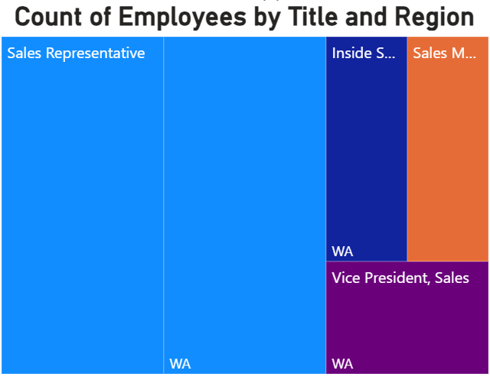
7. What is the count of employees by job title or region? Use stacked bar chart or tree map to visualize.
Conclusion The employee distribution in the Northwind dataset shows that most employees work in sales-related roles, with fewer employees in management or support roles. Employees are also concentrated in key business regions, indicating centralized workforce operations.

Slide 31
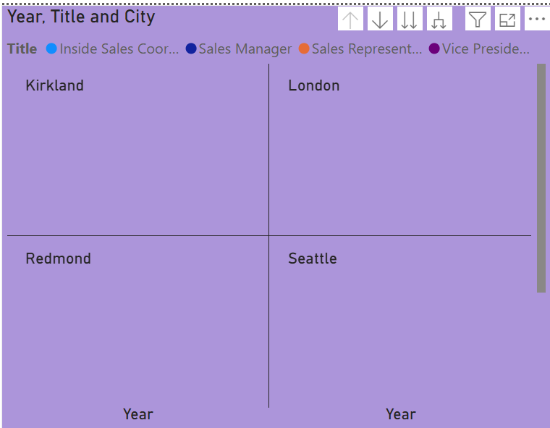
8. What is the distribution of employee tenure? Use histogram or box plot to visualize.
Conclusion The employee tenure distribution in the Northwind dataset shows that most employees have moderate years of service, with fewer very new or very long-tenured employees, indicating a relatively stable workforce.

Slide 32
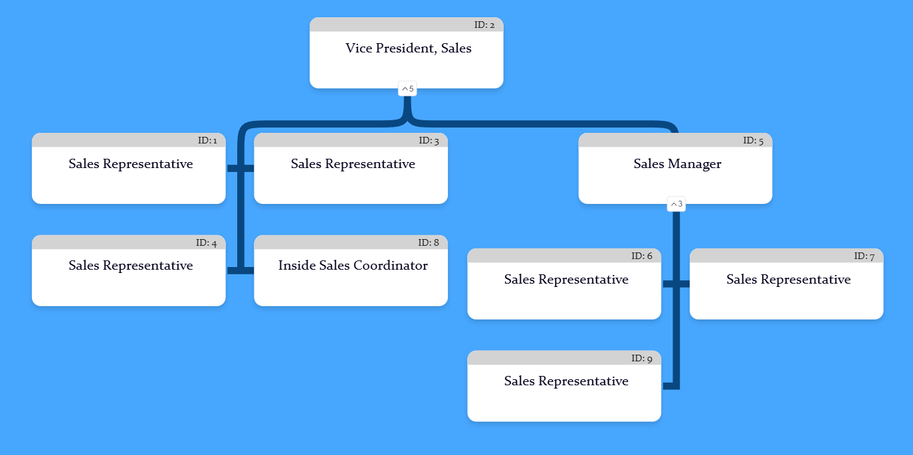
9. What is the reporting structure among employees? Use org chart or hierarchical tree to visualize.
Conclusion The Northwind employee reporting structure follows a hierarchical model with top leadership overseeing managers, who in turn supervise operational staff such as sales representatives. This reflects a structured chain of command.

Slide 33
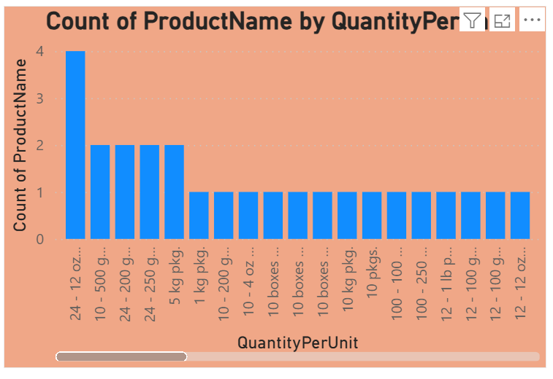
10. Which products have the highest sales volume? Use bar chart or tree map to visualize.
Conclusion ﻿24 - 12 oz bottles had the highest Count of ProductName at 4, followed by 5 kg pkg. and 24 - 250 g pkgs., which tied for second at 2.﻿ 24 - 12 oz bottles accounted for 5.19% of Count of ProductName.﻿ ﻿ Across all 70 QuantityPerUnit, Count of ProductName ranged from 1 to 4.﻿ ﻿

Slide 34
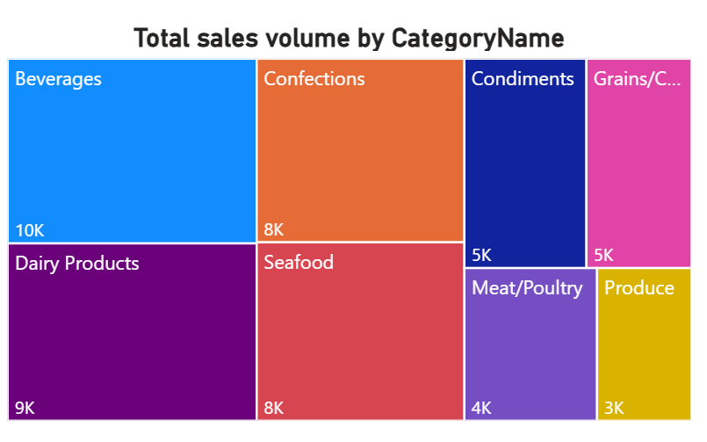
11. How does the sales volume vary across different product categories? Use stacked bar chart or tree map to visualize.
Conclusion Sales volume in the Northwind dataset varies by product category, with categories like beverages and confectionery typically generating the highest sales, while some specialty categories contribute lower sales volumes.

Slide 35
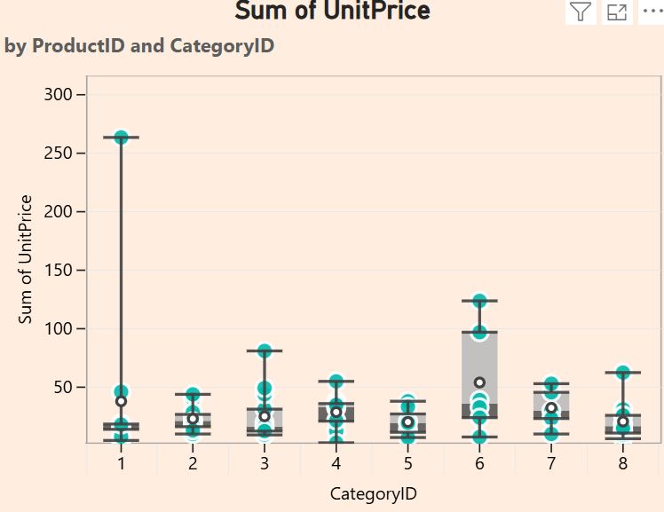
12. Can we visualize the pricing distribution of products? Use box plot or histogram to visualize.
Conclusion The product pricing distribution in the Northwind dataset is typically right-skewed, with most products priced in the low to medium range and a few high-priced premium products appearing as outliers.

Slide 36
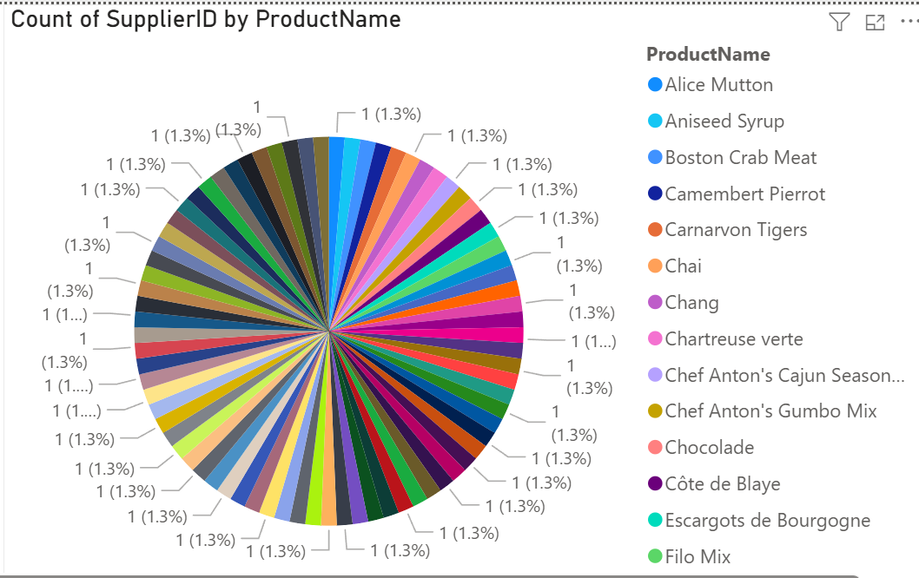
13. How many products are supplied by each supplier? Use bar chart or pie chart to visualize.
Conclusion ﻿More than 50 ProductName tied for the highest Count of SupplierID at 1.﻿

Slide 37
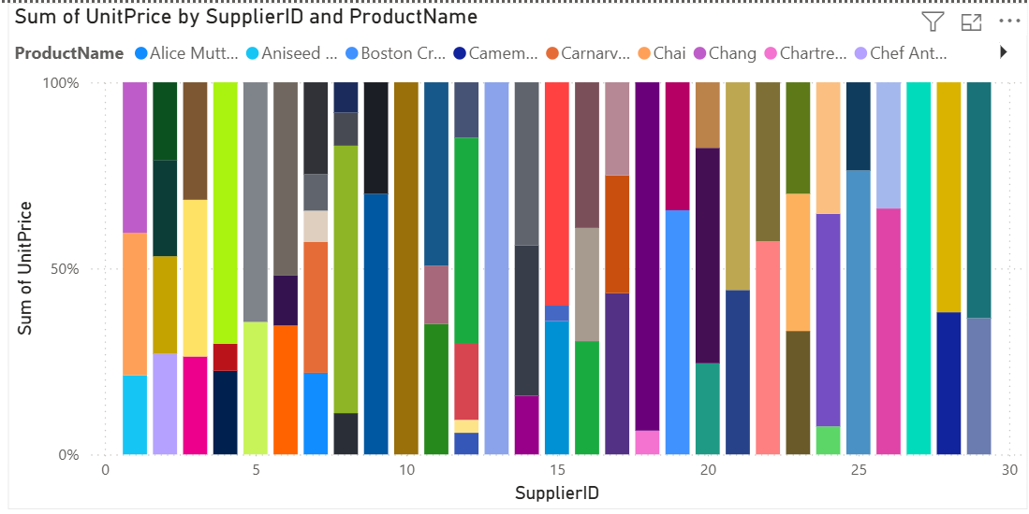
14. How does product pricing vary across different suppliers? Use box plot or stacked column chart to visualize.
Conclusion Product pricing in the Northwind dataset varies across suppliers, with some suppliers offering mostly low-cost products while others provide higher-priced specialty items. Certain suppliers also show wider price ranges, indicating diverse product offerings. .

Slide 38
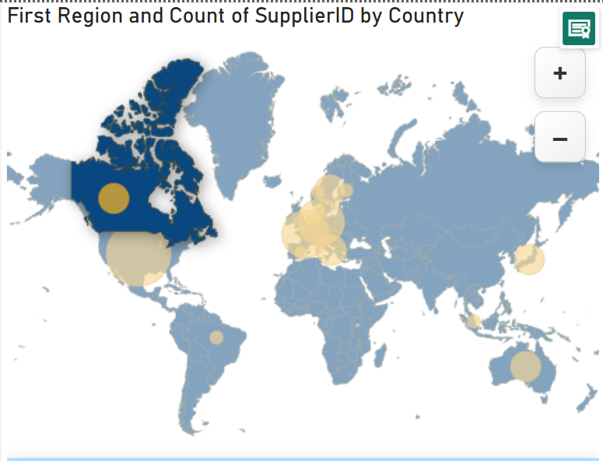
14. What is the geographical distribution of suppliers? Use map chart or bubble map to visualize.
Conclusion The Northwind dataset shows that suppliers are geographically distributed across multiple countries, with higher concentrations in Europe and North America, indicating sourcing from major industrial regions.

Slide 39
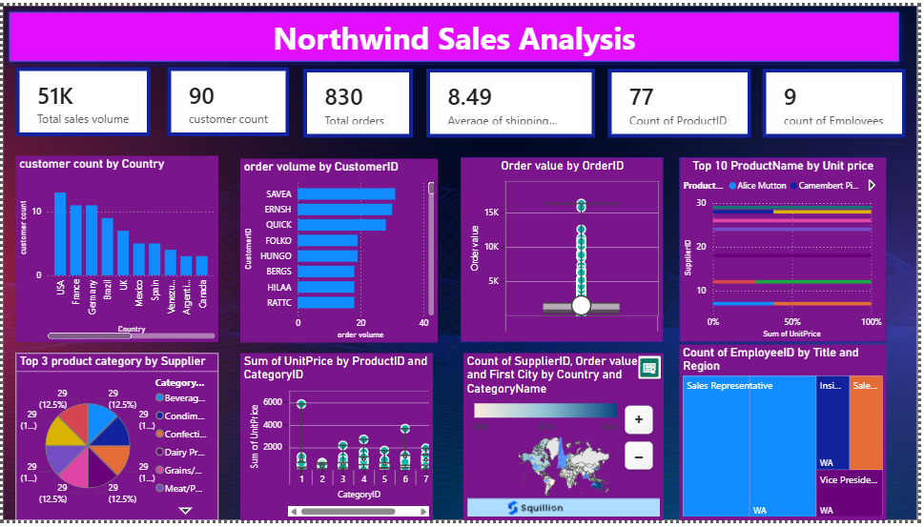

Slide 40
Thank You

